Slide 1
Angular NgRx
The Redux Pattern
Lecture 2
By James(Jin) Wang
10/08/2022

Slide 2
Outline
Store
Actions
Reducers
Advantages of Redux

Slide 3
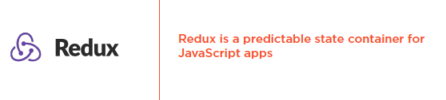
The Redux Pattern

Slide 4
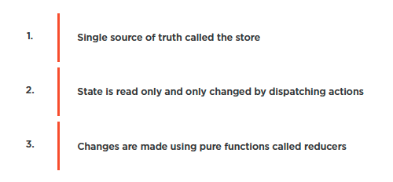
The Redux Pattern
  Redux Principles

Slide 5
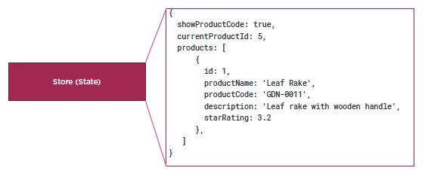
The Redux Pattern
  Store is the Single Source of Truth

Slide 6
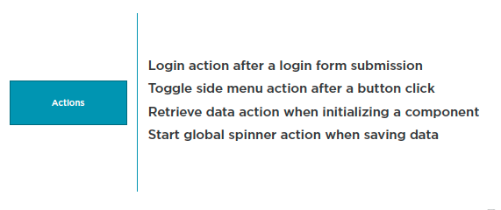
The Redux Pattern
  Dispatch an Action to Change State

Slide 7
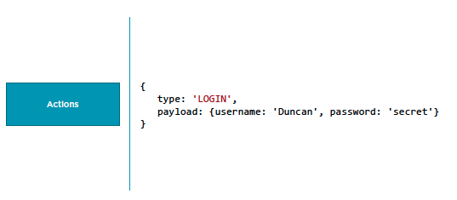
The Redux Pattern
  Dispatch an Action to Change State

Slide 8
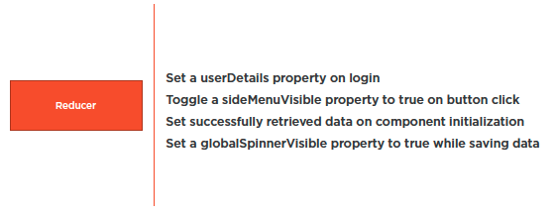
The Redux Pattern
  Use Reducers to Change State

Slide 9
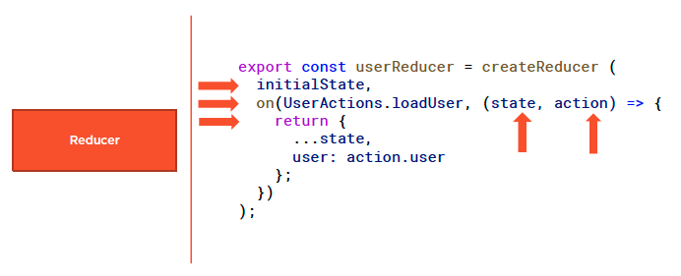
The Redux Pattern
  Reducers are Pure Functions

Slide 10
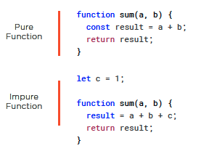
The Redux Pattern
  Pure and Impure Functions

Slide 11
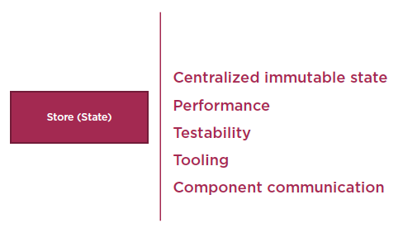
The Redux Pattern
  Advantages of the Redux Pattern

Slide 12
Reference
Angular NgRx: Getting Started
https://app.pluralsight.com/library/courses/angular-ngrx-getting-started/table-of-contents
Play by Play: Angular and ngrx
https://app.pluralsight.com/library/courses/play-by-play-angular-ngrx/table-of-contents

Slide 13
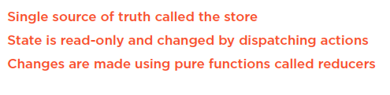
Summary

